Slide 1
Digital Portfolio
STUDENT NAME : RAMYA K
REGISTER NO AND NMID: C216FB06057D86F97024A2C746BA3AEF
DEPARTMENT : BSC(COMPUTER SCIENCE)
COLLEGE/UNIVERSITY : SRI AKILANDESWARI WOMEN'S COLLEGE
WANDIWASH/THIRUVALLUVAR UNIVERSITY

Slide 2
PROJECT TTITLE
Student Digital Portfolio Using Frontend Development

Slide 3
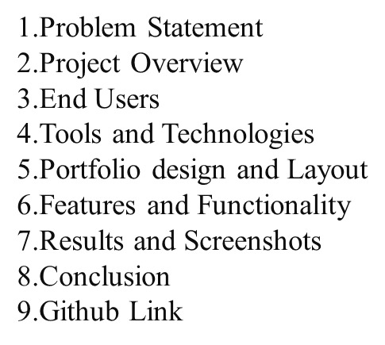


AGENDA
3/21/2024 Annual Review

Slide 4

PROBLEM STATEMENT
Benefits:
Establishing Online Presence: A Portfolio website helps establish a professional online presence.
Showcasing Skills and Experience: It provides platform to showcase skills, experience, and projects.
Uses:
Showcasing Projects: Displaying notable projects and achievements.
Establishing Credibility: Demonstrating expertise and experience in a specific field.

Slide 5

PROJECT OVERVIEW
Brief Summary:
A personal portfolio website showcasing my skills, experience, and projects in a clear and engaging manner.
What My Portfolio Contains:-
About Me: A brief introduction to who I am, my background, and my interests.
Skills : A showcase of my technical skills and expertise.
Projects : A showcase of my notable projects, including descriptions, images, and links
Main Idea:
The main idea of my portfolio is to showcase my achievements, skills, and projects in a way that:-
Demonstrates my expertise : Highlighting my technical skills and experience.
Provides a professional online presence: Establishing a strong online presence for
potential employers, clients, or collaborators.
Showcases my work : Displaying my notable projects and achievements.

Slide 6

WHO ARE THE END USERS?
Potential employers- Clients- Peers and colleagues
Users:
Potential Employers : Employers looking for candidates with specific skills and experience.
Clients: Clients seeking professionals with expertise in specific areas.
Collaborators: Other professionals interested in collaborating on projects.
Individuals: Individuals looking to showcase their work and skills.

Slide 7

TOOLS AND TECHNIQUES
Techniques:
Responsive Web Design: To ensure a seamless user experience across different devices and screen sizes
CSS Custom Properties: For efficient styling and theming.
JavaScript Event Handling: For interactive elements, such as theme toggle and contact form validation.
Front-end Development: For building a client-side interface that interacts with users.
Tools:
HTML5: For structuring and content markup.
CSS3: For styling and layout.
JavaScript: For adding interactivity and dynamic effects.
GitHub: For version control and repository management.
Key Features:
Theme Toggle: Switch between light and dark modes.
Responsive Design: Adapt to different screen sizes and devices.
Contact Form: With validation and submission handling.
Interactive Elements: Such as drag-and-drop avatar upload.

Slide 8
PORTFOLIO DESIGN AND LAYOUT
The portfolio website features a clean, modern design with a responsive layout that adapts to different screen sizes and devices. Here's an overview of the design and layout.
Key Elements:
Clean and Simple Design: Easy to navigate and visually appealing.
2. Responsive Layout: Adapts to different screen sizes and devices.
Clear Typography: Consistent font scheme and clear headings.
Visual Hierarchy: Organized content with clear sections and headings.
Layout:
Header Section: Includes navigation menu and logo.
Hero Section: Introduction to the portfolio with a background image or animation.
About Section: Brief bio and background information.
Projects Section: Showcase of notable projects with images and descriptions.
.
Design Principles:
Consistency : Consistent design elements throughout the portfolio.
Balance : Balanced layout with clear sections and whitespace.
Visual Appeal: Visually appealing design that engages the user.
8

Slide 9
FEATURES AND FUNCTIONALITY
Key Features:
Responsive Design: Adapts to different screen sizes and devices for a seamless user experience.
Theme Toggle : Switch between light and dark modes.
Contact Form : With validation and submission handling.
Project Showcase : A showcase of projects with images, descriptions, and links.
Functionality:
Interactive Elements: Such as theme toggle, contact form, and project links
Smooth Scrolling : Smooth scrolling between sections for a better user experience.
3. Form Validation : Validation of contact form fields to ensure correct input.
4.Submission Handling : Handling of form submissions, such as displaying a success message.
User Experience:
Easy Navigation: A simple and intuitive navigation menu.
Clear Content : Clear and concise content that showcases skills and experience.
Engaging Visuals : Engaging visuals, such as images and icons, to enhance the user experience.

Slide 10

RESULTS AND SCREENSHOTS
The portfolio website project resulted in a fully functional, responsive, and interactive website that showcases skills, experience, and projects. Here are some key results and screenshots:
]
Key Results:
Responsive Design: The website adapts seamlessly to different screen sizes and devices.
Interactive Elements: The theme toggle, contact form, and project links provide an engaging user experience.
Clear Content: The website clearly showcases skills, experience, and projects
Outcomes:
Professional Online Presence: The website provides a professional online presence that showcases skills and experience.
Increased Visibility: The website increases visibility and reach to potential employers, clients, and collaborators.
Improved Engagement: The interactive elements and clear content improve user engagement and experience.
3/21/2024 Annual Review
10

Slide 11
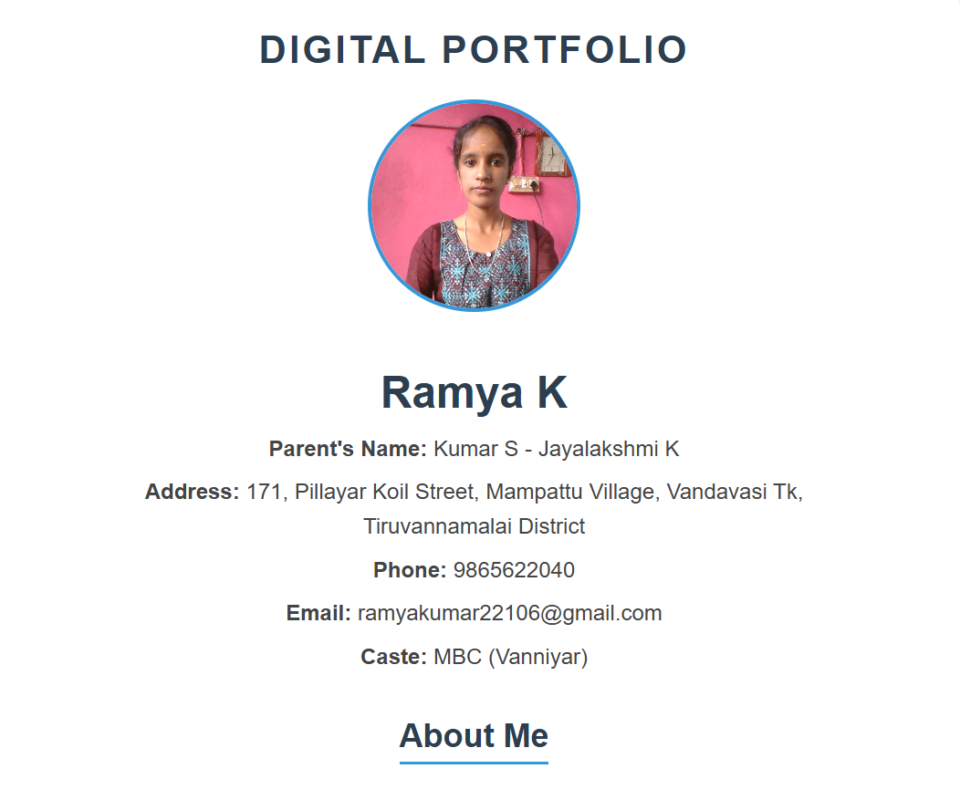
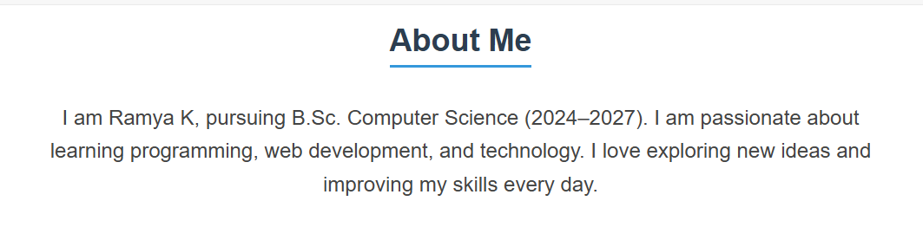

Slide 12

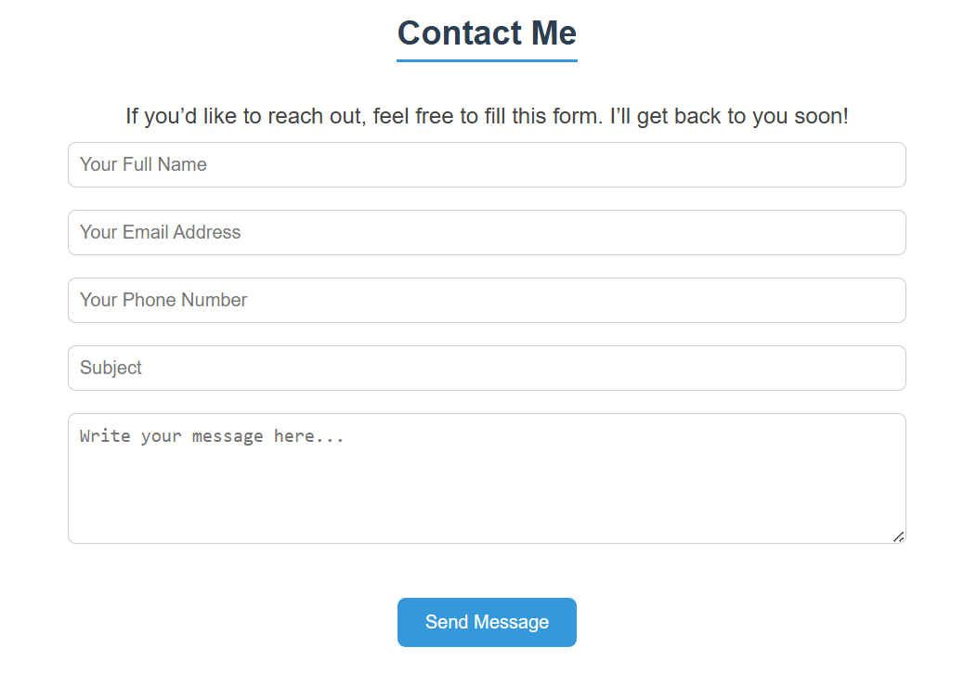

Slide 13
CONCLUSION
The portfolio website project showcases my skills, experience, and projects in a clear and engaging manner, providing a professional online presence.
.
Short Summary:
The portfolio website project demonstrates my ability to design and develop a professional online presence, showcasing my skills, experience, and projects in a clear and engaging manner.
Highlights of Project:
Responsive Design: Adapts to different screen sizes and devices.
Interactive Elements: Theme toggle, contact form, and project links.
Clear Content: Showcases skills, experience, and projects effectively .
Benefits to Society:
Increased Visibility: Provides a platform for individuals to showcase their skills and experience.
Improved Communication: Enables effective communication between individuals and potential employers or clients.
Professional Development: Demonstrates commitment to professional development and online presence
Overall, the portfolio website project provides a valuable online presence, showcasing skills and experience, and demonstrating the importance of professional development in the digital age.
13

